Slide 1
Module 6 – Part 1
Methods and Data Passing

Slide 2
Overview
Terminology
The Return Type
The Method’s Name
Scope of Variables
Parameters
Calling Methods
Runtime Stack
Overloading

Slide 3
Terminology
A function or method is a logical grouping of statements
Reusable chunks of code
Write once
Call as many times as you like
Benefits
Reusable
Easy to work at higher level of abstraction
Reduces complexity
Reduces size of code

Slide 4
Also Known As…
Functions can be called several things, depending on the book or context
Examples:
Procedure
Module
Method (OOP)
Behavior (OOP)
Member function (OOP)

Slide 5
Why have functions?
CREATE average, userNum1, userNum2
PRINT (“Please enter the 2 numbers”)
READ userNum1
READ userNum2
average = (userNum1 + userNum2) / 2
// a lot of other code
READ userNum1
READ userNum2
average = (userNum1 + userNum2) / 2
// more code here, then
READ userNum1
READ userNum2
average = (userNum1 + userNum2) / 2
Ps

Slide 6
Look! This code is the same!
CREATE average, userNum1, userNum2
PRINT (“Please enter the 2 numbers”)
READ userNum1
READ userNum2
average = (userNum1 + userNum2) / 2
// a lot of other code
READ userNum1
READ userNum2
average = (userNum1 + userNum2) / 2
// more code here, then
READ userNum1
READ userNum2
average = (userNum1 + userNum2) / 2
Ps

Slide 7
Instead of Repeating Code
CREATE average, userNum1, userNum2
PRINT (“Please enter the 2 numbers”)
READ userNum1
READ userNum2
average = (userNum1 + userNum2) / 2
// a lot of other code
READ userNum1
READ userNum2
average = (userNum1 + userNum2) / 2
// more code here, then
READ userNum1
READ userNum2
average = (userNum1 + userNum2) / 2
Ps

Slide 8
Create a Function Instead
CREATE average, userNum1, userNum2
PRINT (“Please enter the 2 numbers”)
READ userNum1
READ userNum2
average = (userNum1 + userNum2) / 2
// a lot of other code
READ userNum1
READ userNum2
average = (userNum1 + userNum2) / 2
// more code here, then
READ userNum1
READ userNum2
average = (userNum1 + userNum2) / 2
READ userNum1
READ userNum2
average=(userNum1 + userNum2)/2
Ps

Slide 9
Give the Function a Name
CREATE average, userNum1, userNum2
PRINT (“Please enter the 2 numbers”)
READ userNum1
READ userNum2
average = (userNum1 + userNum2) / 2
// a lot of other code
READ userNum1
READ userNum2
average = (userNum1 + userNum2) / 2
// more code here, then
READ userNum1
READ userNum2
average = (userNum1 + userNum2) / 2
myFunction
READ userNum1
READ userNum2
average=(userNum1 + userNum2)/2
Ps

Slide 10
Then Call the Function Instead
CREATE average, userNum1, userNum2
PRINT (“Please enter the 2 numbers”)
myFunction
// a lot of other code
myFunction
// more code here, then
myFunction
myFunction
READ userNum1
READ userNum2
average=(userNum1 + userNum2)/2
Ps

Slide 11
What have we done?
Written the code once, but called it many times
Reduced the size of our code
Easier to comprehend
This is called procedural abstraction
Tracing of code skips around (no longer top to bottom)

Slide 12
“Modularizing” Code
Software design concept using modules.
Can be used to reduce redundant coding and enable code reuse.
Can also improve the quality of the program.

Slide 13
What is a Method?
Think of a method as a black box that does a specific task. The method may take use inputs (parameters) and may return an output with a specific type.

Slide 14
Defining Methods
A method has a header and a body.
The header is the method declaration.
It’s usually the top line
The body is a collection of statements grouped together to perform an operation.
It’s the rest of the method

Slide 15
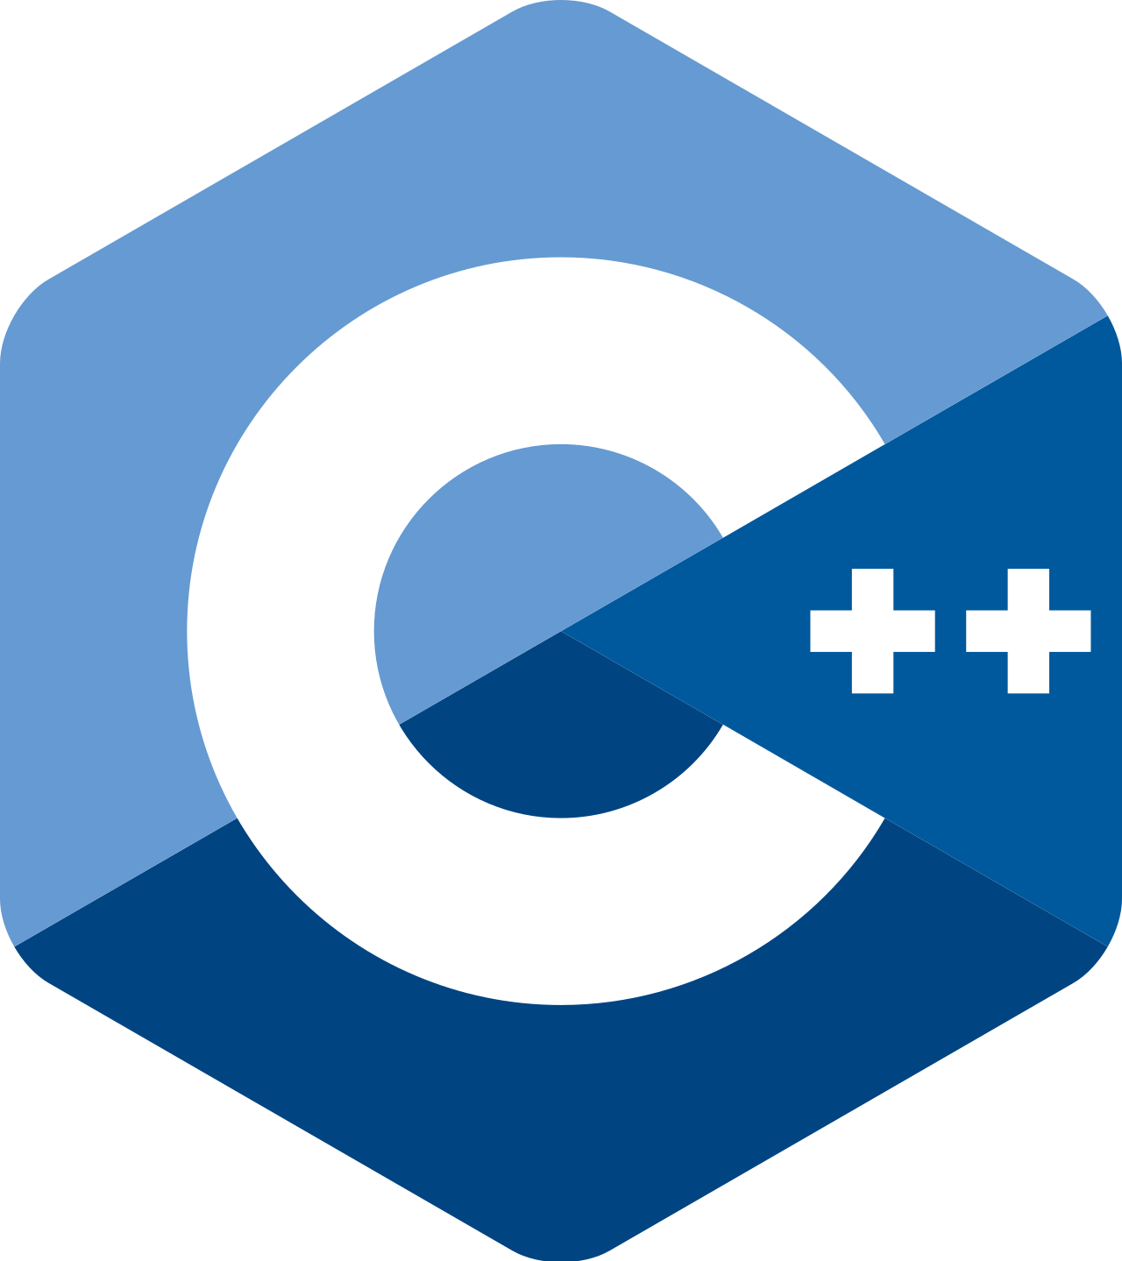
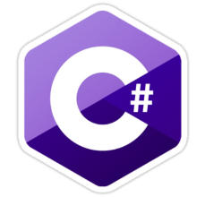
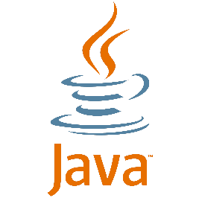
Header/Body Example
// Header is top line
public static int Sum(int num1, int num2)
{ // Begin the body
int sum = 0;
for(int i = num1; i <= num2; i++)
{
sum += i;
}
return sum;
} // End the body

Slide 16
Method Signature
Method signature is the combination of the method name and the parameter list.
It’s part of the top line of the method
Examples of method signatures are circled on the following slide.

Slide 17
Method Signature
// Signature is int Sum (int num1, int num2)
public static int Sum(int num1, int num2)
{
int sum = 0;
for(int i = num1; i <= num2; i++)
{
sum += i;
}
return sum;
}

Slide 18
The return type
The return type is the data type of the value the method returns.
Java and C#:
return type in the method header
use void if no data will be returned.
must be a return statement if return type is not void.

Slide 19
Figure out the return type
Method Name Return type average ?
getLetterGrade ?
areYouAsleep ?
getGPA ?
printMenu ?
getStudentName ?
calculateAverage ?

Slide 20
Figure out the return type
Method Name Return type average double or float
getLetterGrade char
areYouAsleep bool
getGPA double or float
// Don’t confuse what a method does with its return type!
printMenu void
getStudentName string
calculateAverage double or float

Slide 21
The Method’s Name
Similar to naming of variables
Can be almost anything except
A reserved word (keywords)
Can’t begin with a number
Can’t contain strange symbols except _ and $
Method names should begin with a lower case
Different standards/conventions are used
If multiple words in method name, capitalize the first letter in each word (except the first)
Example:
thisIsAnExample

Slide 22
Scope of Variables (or “who can see what”)
Variables within a method can only be seen by that method – called a local variable!
Need a way to send information to the method
Method needs to send back information
Example: method1 can’t see myInt; likewise, method 2 cannot see myChar
method1
method2
myChar
myInt

Slide 23
Technically Speaking…
The scope of a local variable starts from its when it’s declared and continues to the end of the block that contains the variable.
Example:
if (myVar > yourVar) {
int myLocalVariable = 15;
// Other code
}
// myLocalVariable doesn’t exist here

Slide 24
Parameters
Methods cannot see each other’s variables (scope)
Parameters are special variables used to “catch” data being passed
This is the only way the main algorithm and methods have to communicate!
Located between parentheses ( )
If no parameters are needed, leave the parentheses empty

Slide 25
More on Parameters
Variables in the method header are called formal parameters
Values passed to the method are called actual parameters or arguments.
Arguments passed by value mean that a copy is passed to formal parameter (later)
Arguments passed by reference mean the method gets the original and can change it! (later)
In Python, all parameters are passed by reference.

Slide 26
Find the Return Type and Parameters
void doSomething (int data)
double average (int num1, int num2)
boolean didHePass ( )
char whatWasHisGrade ( )
void scareStudent (char gradeOfStudent)

Slide 27
Getting the Method to Work for You
Call it by name
Pass it the right stuff
Pass the right number of parameters
If it expects two things, pass it two things!
Pass the right type of parameters
If it expects a char, don’t pass it a double!
Parameters must match exactly
If it returns something, do something with it!

Slide 28
Example (always start at main)
MAIN ()
{
int num1, num2, num3;
double result1, result2;
num1 = 5; num2 = 7; num3 = 4;
result1 = average (num1, num2);
result2 = average (num3, num1);
}
x
y
double average (int x, int y) {
return ( (x+y) / 2);
}
// Note: the average function is currently inactive

Slide 29
Example (declare variables)
MAIN ()
{
int num1, num2, num3;
double result1, result2;
num1 = 5; num2 = 7; num3 = 4;
result1 = average (num1, num2);
result2 = average (num3, num1);
}
x
y
Memory
num1
num2
num3
?
?
?
double average (int x, int y) {
return ( (x+y) / 2);
}
// Note: the average function is currently inactive

Slide 30
Example (declare variables)
MAIN ()
{
int num1, num2, num3;
double result1, result2;
num1 = 5; num2 = 7; num3 = 4;
result1 = average (num1, num2);
result2 = average (num3, num1);
}
x
y
Memory
num1
num2
num3
?
?
?
double average (int x, int y) {
return ( (x+y) / 2);
}
result1
result2
?
?
// Note: the average function is currently inactive

Slide 31
Example
MAIN ()
{
int num1, num2, num3;
double result1, result2;
num1 = 5; num2 = 7; num3 = 4;
result1 = average (num1, num2);
result2 = average (num3, num1);
}
x
y
Memory
num1
num2
num3
5
7
4
double average (int x, int y) {
return ( (x+y) / 2);
}
result1
result2
?
?
// Note: the average function is currently inactive

Slide 32
Example (call the function)
MAIN ()
{
int num1, num2, num3;
double result1, result2;
num1 = 5; num2 = 7; num3 = 4;
result1 = average (num1, num2);
result2 = average (num3, num1);
}
WAKE UP!
x
y
Memory
num1
num2
num3
5
7
4
double average (int x, int y) {
return ( (x+y) / 2);
}
result1
result2
?
?

Slide 33
Example (data passing)
MAIN ()
{
int num1, num2, num3;
double result1, result2;
num1 = 5; num2 = 7; num3 = 4;
result1 = average (num1, num2);
result2 = average (num3, num1);
}
x
y
Memory
5
7
num1
num2
num3
5
7
4
double average (int x, int y) {
return ( (x+y) / 2);
}
result1
result2
?
?

Slide 34
Example (main falls asleep)
MAIN ()
{
int num1, num2, num3;
double result1, result2;
num1 = 5; num2 = 7; num3 = 4;
result1 = average (num1, num2);
result2 = average (num3, num1);
}
x
y
Memory
5
7
num1
num2
num3
5
7
4
double average (int x, int y) {
return ( (x+y) / 2);
}
result1
result2
?
?
// The function is now ACTIVE

Slide 35
Example (function is doin’ its thing)
MAIN ()
{
int num1, num2, num3;
double result1, result2;
num1 = 5; num2 = 7; num3 = 4;
result1 = average (num1, num2);
result2 = average (num3, num1);
}
x
y
Memory
5
7
num1
num2
num3
5
7
4
double average (int x, int y) {
return ( (x+y) / 2);
}
result1
result2
?
?
// 5 + 7 is 12; 12 / 2 == 6

Slide 36
Example (function finishes and passes info back)
MAIN ()
{
int num1, num2, num3;
double result1, result2;
num1 = 5; num2 = 7; num3 = 4;
result1 = average (num1, num2);
result2 = average (num3, num1);
}
x
y
Memory
5
7
num1
num2
num3
7
4
6
double average (int x, int y) {
return ( (x+y) / 2);
}
5
result1
result2
?
?
// 5 + 7 is 12; 12 / 2 == 6

Slide 37
Example (main wakes back up; average sleeps)
MAIN ()
{
int num1, num2, num3;
double result1, result2;
num1 = 5; num2 = 7; num3 = 4;
result1 = average (num1, num2); // 6
result2 = average (num3, num1);
}
sleep
x
y
Memory
num1
num2
num3
5
7
4
double average (int x, int y) {
return ( (x+y) / 2);
}
result1
result2
6
?

Slide 38
Example (re-using the average function with num3 and num1)
MAIN ()
{
int num1, num2, num3;
double result1, result2;
num1 = 5; num2 = 7; num3 = 4;
result1 = average (num1, num2); // 6
result2 = average (num3, num1);
}
WAKE UP!
x
y
Memory
num1
num2
num3
5
7
4
double average (int x, int y) {
return ( (x+y) / 2);
}
result1
result2
6
?

Slide 39
Example (re-using the average function with num3 and num1)
MAIN ()
{
int num1, num2, num3;
double result1, result2;
num1 = 5; num2 = 7; num3 = 4;
result1 = average (num1, num2);
result2 = average (num3, num1);
}
x
y
Memory
4
5
num1
num2
num3
5
7
4
double average (int x, int y) {
return ( (x+y) / 2);
}
result1
result2
6
?

Slide 40
Example (main asleep, function awake)
MAIN ()
{
int num1, num2, num3;
double result1, result2;
num1 = 5; num2 = 7; num3 = 4;
result1 = average (num1, num2);
result2 = average (num3, num1);
}
x
y
Memory
4
5
num1
num2
num3
5
7
4
double average (int x, int y) {
return ( (x+y) / 2);
}
result1
result2
6
?

Slide 41
Example (function doin’ it again)
MAIN ()
{
int num1, num2, num3;
double result1, result2;
num1 = 5; num2 = 7; num3 = 4;
result1 = average (num1, num2);
result2 = average (num3, num1);
}
x
y
Memory
4
5
num1
num2
num3
5
7
4
double average (int x, int y) {
return ( (x+y) / 2);
}
result1
result2
6
?
// 9 / 2 == 4.0 (integer division)

Slide 42
Example (function doin’ it again)
MAIN ()
{
int num1, num2, num3;
double result1, result2;
num1 = 5; num2 = 7; num3 = 4;
result1 = average (num1, num2);
result2 = average (num3, num1);
}
x
y
Memory
4.0
4
5
num1
num2
num3
5
7
4
double average (int x, int y) {
return ( (x+y) / 2);
}
result1
result2
6
?
// 9 / 2 == 4.0 (integer division)

Slide 43
Example (main wakes back up; average sleeps)
MAIN ()
{
int num1, num2, num3;
double result1, result2;
num1 = 5; num2 = 7; num3 = 4;
result1 = average (num1, num2); // 6
result2 = average (num3, num1); // 4.5
}
sleep
x
y
Memory
num1
num2
num3
5
7
4
double average (int x, int y) {
return ( (x+y) / 2);
}
result1
result2
6
4.0

Slide 44
Another Quick Example (void return types)
MAIN ()
{
int num1, num2, num3;
num1 = 5; num2 = 7; num3 = 4;
printNum (num1);
}
sleep
myNum
void printNum (int myNum) {
PRINT (myNum);
}

Slide 45
Another Quick Example (declare variables)
MAIN ()
{
int num1, num2, num3;
num1 = 5; num2 = 7; num3 = 4;
printNum (num1);
}
sleep
myNum
Memory
num1
num2
num3
void printNum (int myNum) {
PRINT (myNum);
}
?
?
?

Slide 46
Another Quick Example (initialize variables)
MAIN ()
{
int num1, num2, num3;
num1 = 5; num2 = 7; num3 = 4;
printNum (num1);
}
sleep
myNum
Memory
num1
num2
num3
void printNum (int myNum) {
PRINT (myNum);
}
5
7
4

Slide 47
Another Quick Example (call the function)
MAIN ()
{
int num1, num2, num3;
num1 = 5; num2 = 7; num3 = 4;
printNum (num1);
}
WAKE UP!
myNum
Memory
num1
num2
num3
void printNum (int myNum) {
PRINT (myNum);
}
5
7
4

Slide 48
Another Quick Example (data passing)
MAIN ()
{
int num1, num2, num3;
num1 = 5; num2 = 7; num3 = 4;
printNum (num1);
}
myNum
Memory
5
num1
num2
num3
void printNum (int myNum) {
PRINT (myNum);
}
5
7
4

Slide 49
Another Quick Example (function does its thing; main asleep)
MAIN ()
{
int num1, num2, num3;
num1 = 5; num2 = 7; num3 = 4;
printNum (num1);
}
myNum
Memory
5
num1
num2
num3
void printNum (int myNum) {
PRINT (myNum);
}
5
7
4

Slide 50
Another Quick Example (function does its thing; main asleep)
MAIN ()
{
int num1, num2, num3;
num1 = 5; num2 = 7; num3 = 4;
printNum (num1);
}
Output
5
myNum
Memory
5
num1
num2
num3
void printNum (int myNum) {
PRINT (myNum);
}
5
7
4

Slide 51
Another Quick Example (function is done)
MAIN ()
{
int num1, num2, num3;
num1 = 5; num2 = 7; num3 = 4;
printNum (num1);
}
Output
5
myNum
Memory
5
num1
num2
num3
void printNum (int myNum) {
PRINT (myNum);
}
5
7
4

Slide 52
Another Quick Example (function falls asleep; main awake)
MAIN ()
{
int num1, num2, num3;
num1 = 5; num2 = 7; num3 = 4;
printNum (num1);
}
Output
5
myNum
Memory
num1
num2
num3
void printNum (int myNum) {
PRINT (myNum);
}
5
7
4

Slide 53
In-class Problem
Problem Statement:
Find the sum of integers from 1 to 10, from 20 to 30, and from 35 to 45, respectively.

Slide 54
Psuedocode - A Bad Solution (where is the repeated code?)
Ps
sum ← 0
FOR (i ← 1 i <= 10 i ← i+1)
sum ← sum + i ENDFOR
PRINT("Sum from 1 to 10 is “, sum)
sum ← 0
FOR (int i ← 20 i <= 30 i ← i+1)
sum ← sum + i ENDFOR
PRINT("Sum from 20 to 30 is “, sum)
sum ← 0
for (int i ← 35 i <= 45 i ← i+1)
sum ← sum + i ENDFOR
PRINT("Sum from 35 to 45 is “, sum)

Slide 55
Ps
METHOD MAIN () BEGIN CREATE result ← SUM(arguments: 1,10) PRINT("Sum from 1 to 10 is:”, result) result ← SUM(arguments: 20,30) PRINT("Sum from 20 to 30 is:”, result) result ← SUM(arguments: 35,45) PRINT("Sum from 35 to 45 is:”, result) END MAIN () METHOD SUM(parameters: num1, num2) BEGIN CREATE sum ← 0 FOR (i ← num1, i <= num2, i ← i+1 ) sum ← sum + i ENDFOR RETURN sum END SUM

Slide 56
Java Example – Method Sum
public static int Sum(int num1, int num2)
{
int sum = 0;
for(int i = num1; i <= num2; i++)
{
sum += i;
}
return sum;
}
public static void main(String[] args)
{
int result = Sum(1, 10);
System.out.println("Sum from 1 to 10 is " + result);
result = Sum(20, 30);
System.out.println("Sum from 20 to 30 is " + result);
result = Sum(35, 45);
System.out.println("Sum from 35 to 45 is " + result);
}

Slide 57
C# Example – Method Sum
public static int Sum(int num1, int num2)
{
int sum = 0;
for(int i = num1; i <= num2; i ++)
{
sum += i;
}
return sum;
}
public static void Main(string[] args)
{
int result = Sum(1, 10);
Console.WriteLine("Sum from 1 to 10 is " + result);
result = Sum(20, 30);
Console.WriteLine("Sum from 20 to 30 is " + result);
result = Sum(35, 45);
Console.WriteLine("Sum from 35 to 45 is " + result);
}

Slide 58
C++ Example – Method Sum
static int sum(int num1, int num2) {
int sum = 0;
for (int i = num1; i <= num2; i++) {
sum += i;
}
return sum;
}
int main() {
int result = sum(1, 10);
cout << "Sum from 1 to 10 is " << result << endl;
result = sum(20, 30);
cout << "Sum from 20 to 30 is " << result << endl;
result = sum(35, 45);
cout << "Sum from 35 to 45 is " << result << endl;
return 0;
}

Slide 59
Next Problem
Problem Statement: Write a method that accepts two integers via parameters, determines the largest number, and returns that value.

Slide 60
Psuedocode - Method Max
Ps
METHOD MAIN () BEGIN CREATE i ← 5 CREATE j ← 2 CREATE k ← max(i, j)
PRINT("The maximum of ", i , " and ” , j ," is ", k) END MAIN ()
METHOD MAX(parameters: num1, num2) BEGIN CREATE result if (num1 > num2) result ← num1 else result ← num2 RETURN result END MAX
60

Slide 61
static int max(int num1, int num2) { int result; if (num1 > num2) result = num1; else result = num2; return result; }
MAIN () {
int i = 5, j = 2; int k = max(i, j);
PRINT("The maximum of "+i+" and "+j+" is "+k); }

Slide 62
The Runtime Stack
The runtime stack keeps track of active (currently running) methods in the program, and order of method calls.
The top of the stack represents the currently running (active) method in the program.
The bottom represents main method often program.
When a method finished, it is removed from the stack.
We’ll study these later when we talk about “recursion”
62

Slide 63
Call Stacks

Slide 64
Overloading Methods
Overloading is create a multiple functions with the same name, but different types of parameters (type and/or number).
The IDE knows which method to call based on the parameters that are passed to it.

Slide 65
static int math(int x, int y) {
return x+y;
}
static int math (int x) {
return x*x;
}
static double math(double x, double y) {
return x*y;
}
static String math (){
return "Why does this work?";
}
MAIN ( ) {
PRINT(math(7.5, 9.5)); // Prints 71.25
PRINT (math(4)); // Prints 16
PRINT (math()); // Prints ”Why does this work?”
}

Slide 66
Final Rules
You cannot define a method inside of another method
Methods always reside in a class in C# and Java (as you’ve seen numerous time already)
Methods cannot see each other’s variables
You’ve seen “private static” in our examples… more on this later

Slide 67
End of Module 5

